Slide 1
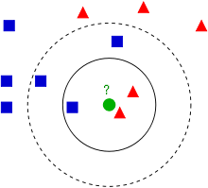
k-nearest neighbors (kNN)
Concept: an object is classified by a majority vote of its neighbor.
Source: Wikipedia

